Slide 1
PRACTICING
EVIDENCE-BASED MEDICINE WITH SHOCK WAVE

Slide 2

CuraMedix and Storz Medical
  CuraMedix is the leading US distributor of STORZ Medical’s EPAT devices and has been affiliated with the company since 2007.

Slide 3
Introduction and History of EPAT
THEN
  The technology was originally developed
  and used for the mechanical destruction
  of urologic stones.
NOW
  Acoustic pressure waves have evolved in
  the regenerative medicine space and are
  now successfully used to treat a broad range of musculoskeletal disorders including:
    Musculoskeletal Pain
    Connective Tissue Disorders
    Degenerative Conditions
    Overuse, Work & Sports Related Injuries
    Trigger Points
    Spine
    Bone Healing Disorders
    Aesthetic Disorders
    Urology/ Men’s Health
    Wound Healing/ Skin lesions
    Ischemic heart disease

Slide 4
EPAT Overview

Slide 5
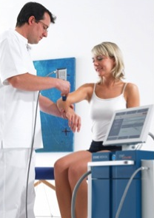
What is EPAT?
EPAT (EXTRACORPOREAL PULSE ACTIVATION TECHNOLOGY)
  EPAT is a proprietary technology platform based on unique sets of acoustic pressure waves.
  It is the most advanced, non-invasive treatment for acute and chronic musculoskeletal pain.

Slide 6
How Does It Work?
EPAT PROVIDES A MECHANICAL STIMULUS,
USING ACOUSTIC PRESSURE WAVES, THAT CAUSES A BIOLOGICAL RESPONSE IN TREATED TISSUE, WHICH STIMULATES AND ACCELERATES THE HEALING PROCESS.
SPECIFICALLY, THE ACOUSTIC PRESSURE WAVES:
  Induce angiogenesis and mechanotransduction,
  Provide a vascular response,
  Enhance blood circulation,
  Break down adhesions and scar tissue,
  And, accelerate the healing process.

Slide 7
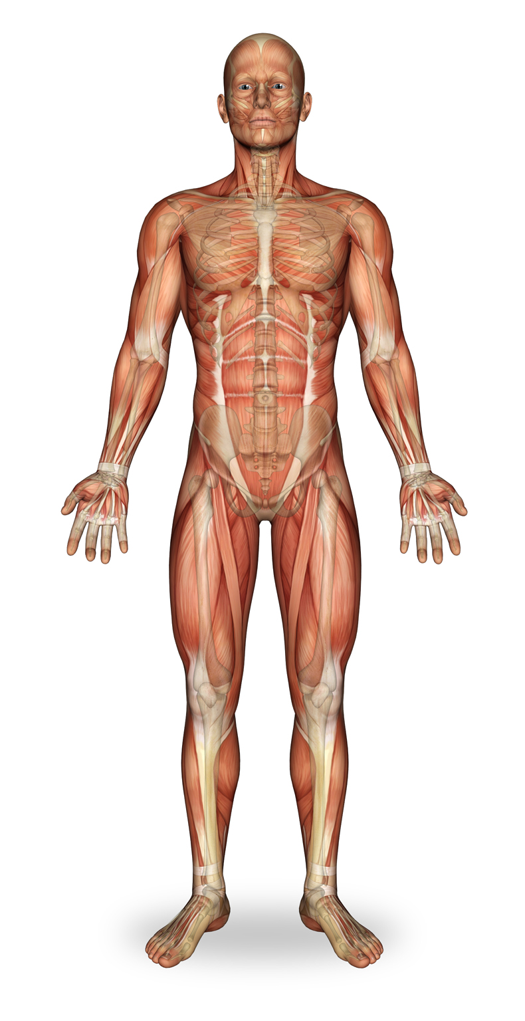
Patient Candidates
EPAT IS AN IDEAL OPTION FOR
THOSE PATIENTS WHO SUFFER FROM ACUTE AND CHRONIC PAIN INCLUDING:
  Neck pain
  Shoulder pain
  Upper back pain
  Lower back pain
  Upper arm and elbow pain
  Forearm, wrist and hand pain
  Pelvis and hip pain
  Thigh and knee pain
  Lower leg pain
  Foot, ankle and heel pain

Slide 8
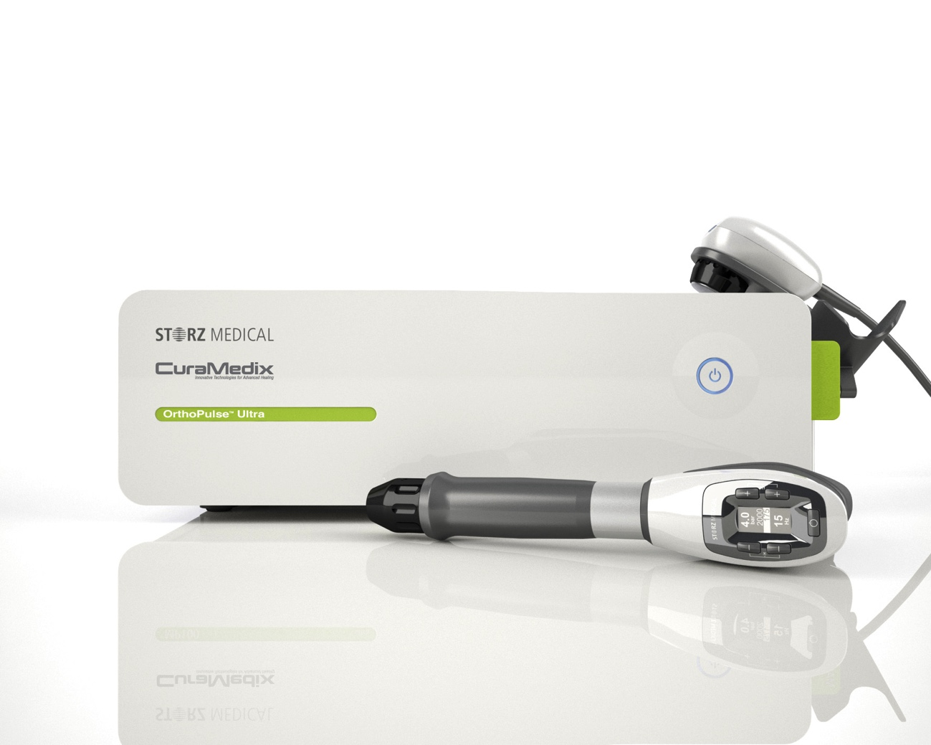
The Advantages of EPAT
EPAT DEVICES ALLOW PHYSICIANS TO:
  Intervene earlier
  Treat the pain’s root cause
  Accelerate healing
  Provide a non-invasive, long-term healing solution without incisions eliminating scar tissue formation,
  risk of infection
  Reduce patient expenditures

Slide 9
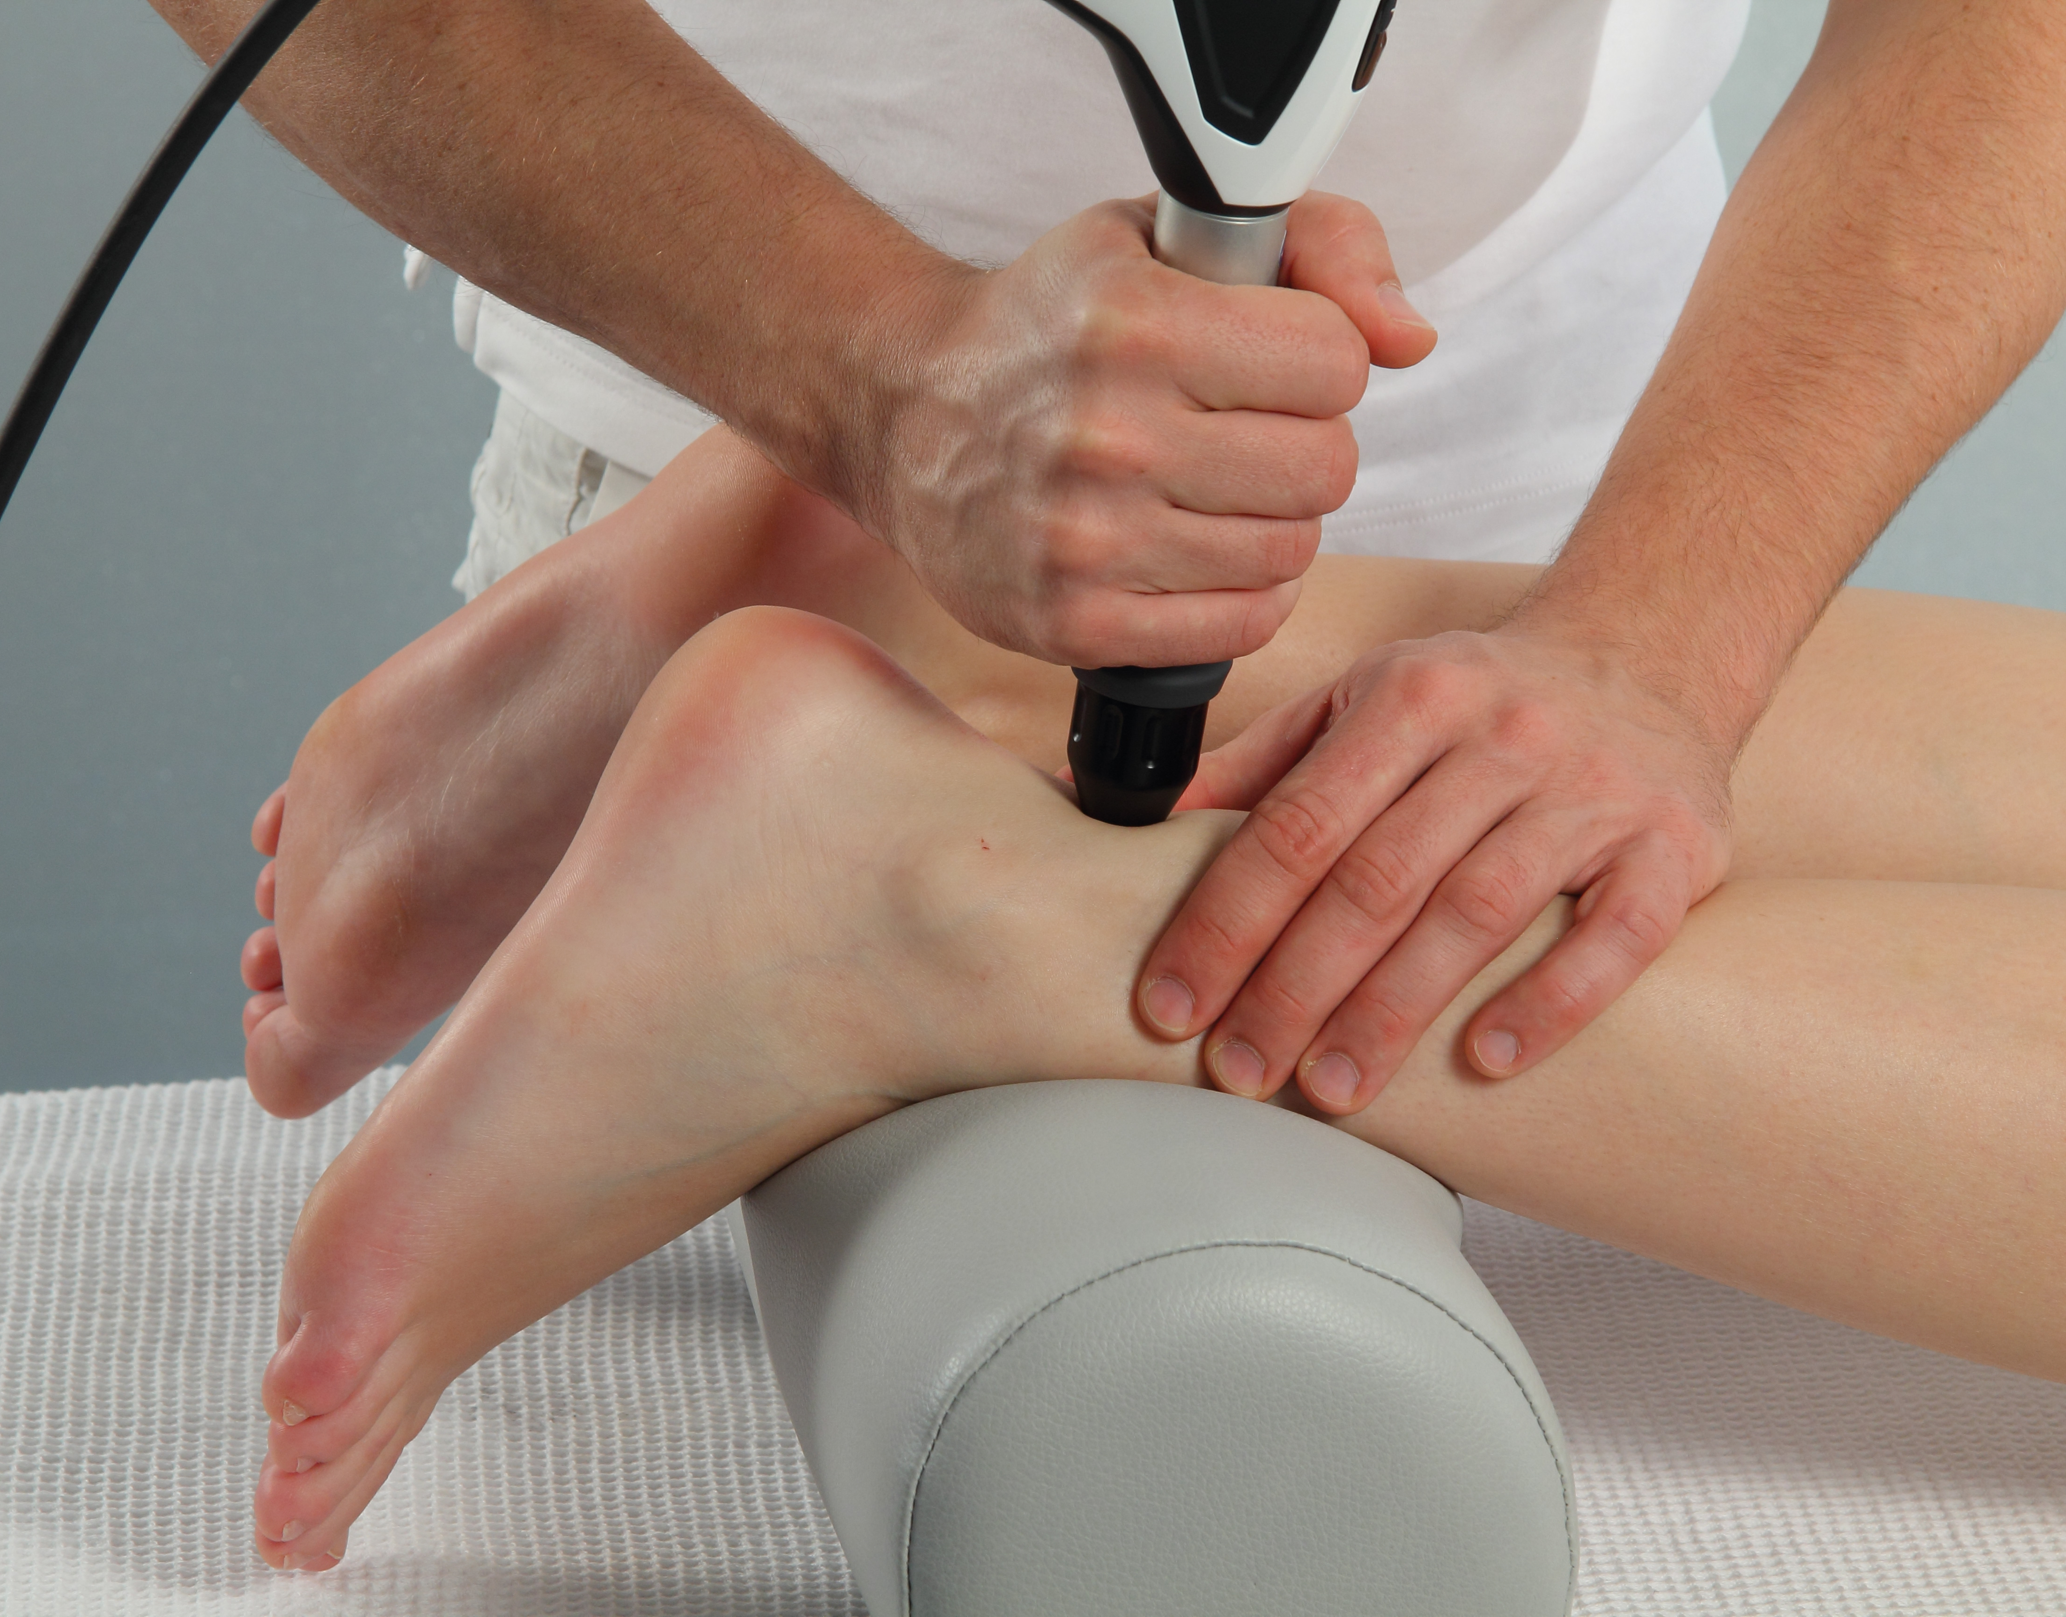
How is the Treatment Performed?
Coupling gel is applied to the specified treatment area to enhance effectiveness.
EPAT pressure waves are then released via the applicator and moved over the area in a circular motion.

Slide 10
Reasons Why Physicians Invest in EPAT
Clinical Advantages
  Evidence-based
  Non-invasive
  Effective and efficient
  Easy to integrate
  Versatile and mobile
  Easy to use
  Small footprint
Economic Advantages
  Cash flow opportunity
  Control procedure costs/payments
  Low acquisition and
  operating costs
  Health insurance provider validation not needed
  Administer on first visit
  and/or as needed
  Patient Care Advantages
  High patient compliance
  High Efficacy
  High patient satisfaction
  Quick prep for patient
  Low risk
  Able to avoid surgery
  Lower patient costs

Slide 11
Clinical Benefits of EPAT
FASTER, EASIER HEALING
  Evidence-based
  Non-invasive
  No anesthesia
  No risk of infection
  No scarring
  No down time
  Less pain
  Improved clinical outcomes
  Can treat bilaterally
  Does not narrow future treatment options
  No scar tissue formation
  or change in biomechanics
  Improved patient compliance
  Over 80% patient satisfaction

Slide 12
The Effects of EPAT
  Reduces/eliminates pain
    Effect on nociceptors:
    → c-fibres (slow)
    Inhibited by a-delta-fibres (fast)
    Analgesic effect
  Increases circulation
  and metabolism
  Stimulates neovascularization
  Stimulates tissue and
  bone growth
    Tissue engineering (mense)
  Biological mechano-transduction
    Cell proliferation (neuland)
  Dissolves calcium deposits
  Reduces muscle tension
  Antibacterial effects

Slide 13
Science + Physics

Slide 14
What Are Acoustic Pressure Waves?
ACOUSTIC PRESSURE WAVES ARE:
  Mechanical waves
  Sound waves
  Require an elastic medium
  for propagation, i.e.
    Water
    Air
    Tissue

Slide 15
Characteristics
Continuous Ultrasound Wave
Acoustic Pressure Wave
  Pulses propagate into the tissue
  No thermal effect
  No micro lesions

Slide 16
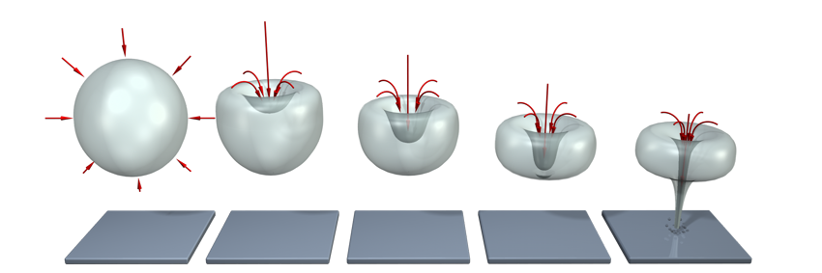
Biologic Effects of
Acoustic Pressure Waves
  Disruption of cell membranes
  Neovascularization
  Stimulate osteoblasts, chondroblasts, macrophages

Slide 17
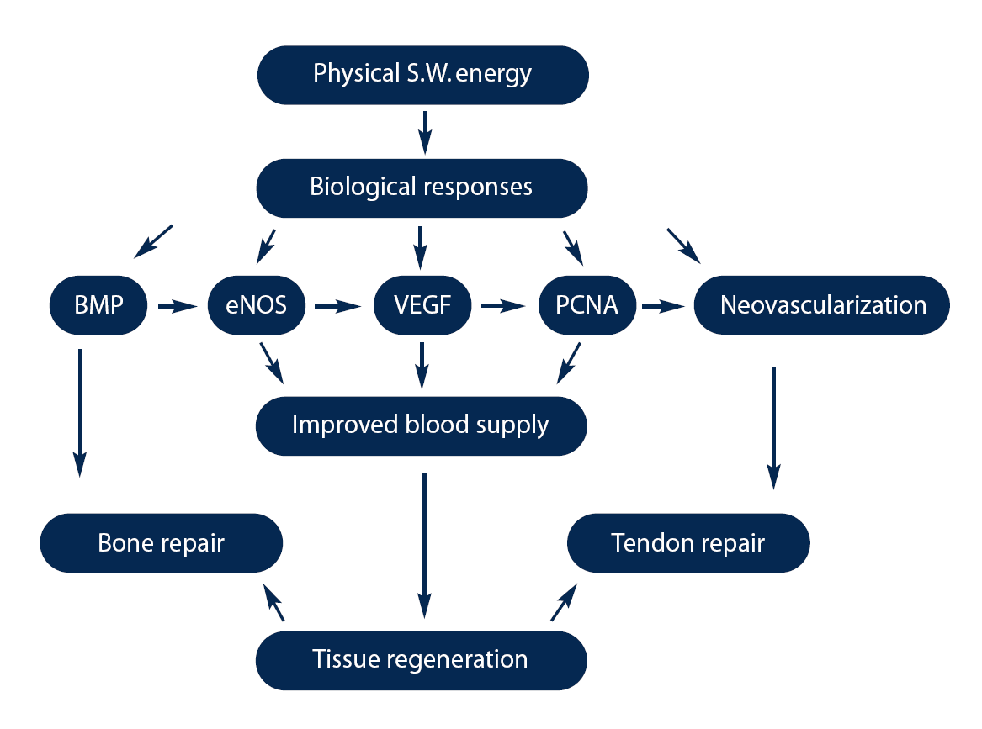
Biologic Effects of
Acoustic Pressure Waves
ACOUSTIC WAVES
BIO-CHEMISTRY

Slide 18
Biologic Effects of
Acoustic Pressure Waves
  Stimulation of microcirculation (blood, lymph) and metabolism
    nitrous oxide, vasodilation, reduction of oxidative stress
  Mechanotransduction –
  cell matrix stimulation
  Increase of cell
  wall permeability
    Cell metabolism
  Release of substance P
    An important element in pain perception
  Antibacterial and
  anti-inflammatory effect
  Stimulation of growth factors
    neogenesis of vessels,
    bone, collagen
  Stimulation of stem cells
    cell proliferation, transport and differentiation, skin rejuvenation
  Analgesic effect
    inhibition of nociceptive fibres – gate mechanism, endorfines and serotonine release, acceleration
    of substance P washout

Slide 19
CLINICAL EVIDENCE

Slide 20

CLINICAL EVIDENCE
JOURNAL OF FOOT AND ANKLE SURGERY-2002
Extracorporeal Shock Wave Therapy for the Treatment of Chronic Plantar Fasciitis: Indications, Protocol, Intermediate Results, and a Comparison of Results to Fasciotomy
Weil LS Jr, Roukis TS, Weil LS, Borrelli AH

Slide 21
CLINICAL EVIDENCE
JOURNAL OF FOOT AND ANKLE SURGERY-2002
Extracorporeal Pulsed Activated Therapy (“EPAT” sound wave) for Achilles Tendinopathy: A Prospective Study
Saxena A, Ramdath S Jr, O'Halloran P, Gerdesmeyer L, Gollwitzer H

Slide 22

CLINICAL EVIDENCE
AMERICAN JOURNAL OF SPORTS MEDICINE-2008
Radial Extracorporeal Shock Wave Therapy is Safe and Effective in the Treatment of Chronic Recalcitrant Plantar Fasciitis: Results of a Confirmatory Randomized Placebo-
Controlled Multicenter Study
Gerdesmeyer L, Frey C, Vester J, Maier M, Weil L Jr, Weil L Sr, Russlies M, Stienstra J, Scurran B, Fedder K, Diehl P, Lohrer H, Henne M, Gollwitzer H

Slide 23
EPAT Procedure and Expectations

Slide 24
The procedure
PATIENT EXPECTATIONS
  Includes a minimum of 3-5 treatments at intervals of once per week
    More chronic conditions may require more sessions
  Takes about 5-10 minutes
  Paid for by the patient up front
    This helps with patient compliance and treatment success
  $450-$750 for a series of 3-5 treatments
  Performed by a medical professional
    Physician’s diagnosis and response to patient plays an important role

Slide 25
Contraindications
SHOCK WAVE TREATMENT SHOULD NOT BE USED IN THE FOLLOWING CASES:
  Coagulation disorders (hemophilia)
    Use of anticoagulants, especially Marcumar
  Thrombosis
    Tumor diseases, carcinoma patients
  Pregnancy
  Cortisone therapy up to 4-6 weeks before first EPAT treatment
Note: Generally speaking, acoustic pressure must not be applied to target areas located above air-filled tissue (lungs), nor to large nerves, vessels, the spinal column or head.

Slide 26
Possible Side Effects
PATIENTS MAY EXPERIENCE:
  Swelling
  Reddening
  Hematomas
  Petechiae
  Pain
  Skin lesions in case of previous cortisone therapy
Note: Side effects generally abate after 2 to 5 days. Make sure they have disappeared before starting the next treatment session.

Slide 27
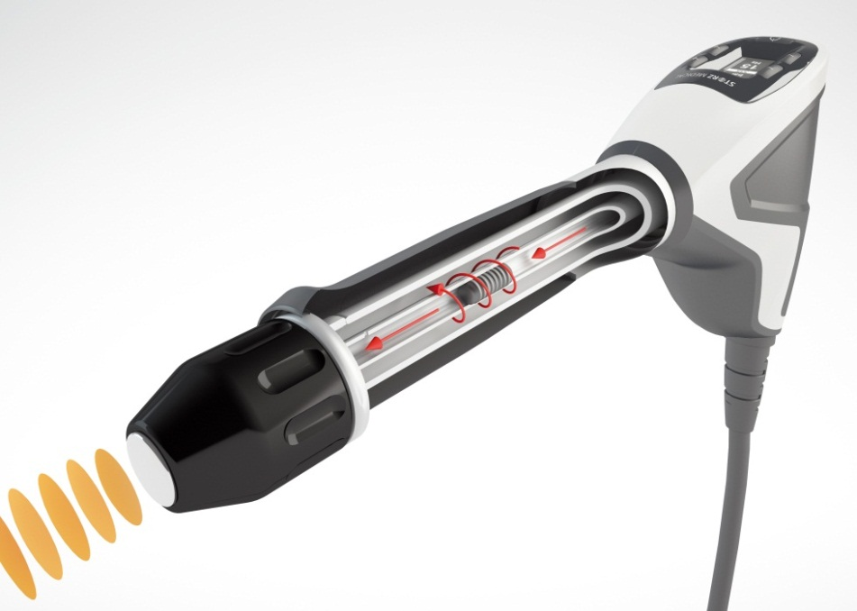
Radial Technology
RADIAL
Frequency 1 – 21 Hz
Energy 0.3 – 5 bar
Energy (D-ACTOR®) 0.16-0.63 mJ/mm²
Penetration depth 0-60 mm
Pulse transmitters multiple
Radial
Slower pulse
Lower energy
More superficial

Slide 28
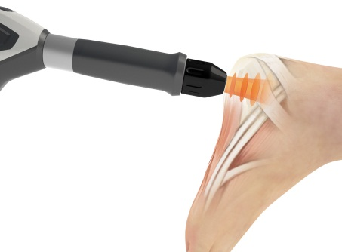
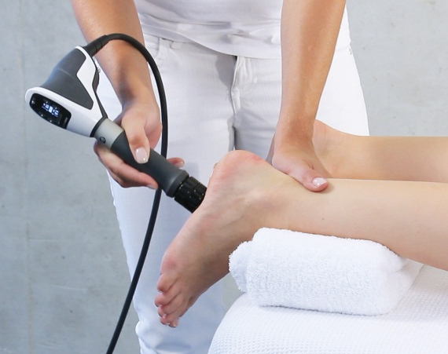
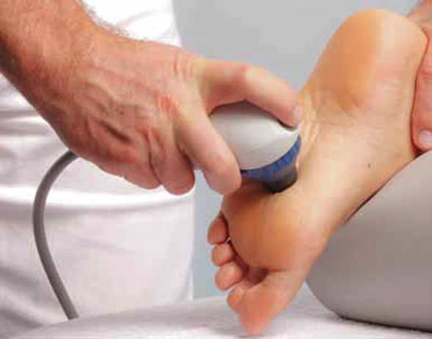
Application example:
Treatment STEPS for Foot & Ankle Pain
STEP 1: D-ACTOR®
STEP 2: D-ACTOR®
STEP 3: V-ACTOR®
Transmitter:
F15, R15, DI15, C15
Parameters:
8 – 15 Hz; 1.0 – 3.5 bar
Number of pulses:
1500 – 3500
Transmitter:
D20-S, D20-T
Parameters:
15 – 21 Hz; 1.0 – 3.5 bar
Number of pulses:
2000 – 4000
STEP 3: V-ACTOR®
Parameters:
25 – 35 Hz; 2.0 – 3.0 bar
Number of pulses:
5000 – 10000

Slide 29
To learn more about shock wave
Visit www.curamedix.com to download the white paper “The Art of Shock Wave”

